Slide 1
Machine Learning Decisions and Deployment
Lesson 21.3

Slide 2
Class Objectives
By the end of this lesson, you will be able to:
Assess the trade-offs between machine learning models.
Choose and build and appropriate machine learning model for a given dataset and business case.
Design an appropriate machine learning pipeline.
Create and deploy a machine learning pipeline.

Slide 3
Revisiting the Great Debate
Notes:
📣 1.1 Instructor Do: Revisiting the Great Debate (5 min)

Slide 4




Instructor Do: Revisiting the Great Debate
Thought Experiment #1
Which do Americans prefer: Italian or Mexican food?

Slide 5
Which steps of the analytics paradigm could benefit from machine learning?

Slide 6
Revisiting the Great Debate
Here are some ideas:
Decompose the question.
Identify data sources.
We could build a pipeline to automatically retrieve and clean the data.
Analyse for trends.
Acknowledge limitations of the analysis / make the call or tell the story.

Slide 7
Groups Do: The Great Debate Revisited
In groups, come up with another strategy to try and answer the question: “Which do Australians prefer: Italian or Thai food?” Consider what trade-offs need to be made, and be ready to discuss with the class.
15 minutes
Notes:
✏️ 1.2 Groups Do: The Great Debate Revisited (15 min)

Slide 8
Notes:
⭐ 1.3 Review Activity (15 min)

Slide 10
A Better Question for Machine Learning
Notes:
📣 2.1 Instructor Do: A Better Question for Machine Learning (5 min)

Slide 11
We’ll tweak the question from the previous activity to focus on something more appropriate for machine learning.

Slide 12

Thought Experiment 2
You are interviewing at
As part of the process, they have asked you to complete a take-home assignment:
Create and train a model to predict a Yelp user’s average rating of Italian restaurants.
⭑
⭑
⭑
⭑
⭑

Slide 13
Thought Experiment 2
Assume the following:
The model must use data from the Yelp dataset.
You will have one week to work on the assignment.
You may use external libraries, but you must be able to explain how they work at a high level.
You should be prepared to explain how your model works to interviewers of varying technical backgrounds.

Slide 14

We’ll base our analysis on a real dataset, but this dataset is over 6 GB compressed.
Instead of writing any code or downloading the data, we’re going to make a hypothetical plan and rely on the data description from Yelp to guide how we will approach the data.
Notes:
shutterstock_2036443016

Slide 15
Groups Do: Preference Predictor
Break into groups again, and develop a plan to create a machine learning model that predicts a Yelp user’s average rating of Italian restaurants. Be ready to discuss your ideas with the class.
25 minutes
Notes:
✏️ 2.2 Groups Do: Preference Predictor (15 min)

Slide 16
Notes:
⭐ 2.3 Review Activity (15 min)

Slide 18
Preference Predictor Critique
15 Minutes
Notes:
⭐ 2.4 Everyone Do: Preference Predictor Critique (15 min)

Slide 20

Notes:
Image source: AdobeStock_56885471

Slide 21

Amazon SageMaker Introduction and Setup
Notes:
📣 3.1 Instructor Do: Introduce Amazon SageMaker (5 min)

Slide 22
Amazon SageMaker Introduction and Setup
Up until now, all the models we’ve created run within a Jupyter notebook.
If we want to share the functionality of our models with other people (or other programs), we need to deploy them.
One way to deploy models is to build an API from scratch using Flask, but that takes a lot of work, plus the API needs to be hosted on a server.

Slide 23

The rest of the session will be about deploying machine learning models using Amazon SageMaker.
Notes:
shutterstock_1095077426_data

Slide 24
Amazon SageMaker is a tool offered by AWS that streamlines the process of training and deploying models in the cloud.

Slide 25
Creating an Administrator User on IAM
Notes:
📣 3.2 Instructor Do: Creating an Administrator User on IAM (10 min)

Slide 26
A standard best practice is to avoid using the principal, or root, user to manage your AWS account.

Slide 27
Use the AWS Identity and Access Management (IAM) service to create a new user for each person that requires administrator access.

Slide 29
Activity: Creating an Admin User on IAM
In this activity, you will create an administrator user to manage your AWS account.
10 minutes
Notes:
✏️ 3.3 Students Do: Creating an Admin user on IAM (10 min)

Slide 30
Notes:
📣 3.4 Instructor Do: Review Creating an Admin User on IAM (10 min)

Slide 31
Amazon SageMaker Notebooks

Slide 32
Create an Amazon SageMaker Notebook Instance
20 Minutes
Notes:
✏️ 4.1 Everyone Do: Create an Amazon SageMaker Notebook Instance (20 min)

Slide 33
The first component that Amazon SageMaker requires is an Amazon S3 bucket.

Slide 34



Storage with AWS S3
S3 uses buckets to store files, which are similar to computer folders or directories. Buckets can contain additional folders and files. Each bucket must have a unique name.
S3 has fine-grained control over files, such as read and write permissions. Buckets can assign individual access or total public access.
The S3 bucket structure is somewhat similar to a GitHub repository, which also holds files and folders.

Slide 35

Storage with AWS S3
x
An S3 bucket can contain files, but it cannot contain another bucket.

Slide 37
Create and Deploy a Machine Learning Model in Amazon SageMaker
30 Minutes
Notes:
✏️ 4.2 Everyone Do: Create and Deploy a Machine Learning Model in Amazon SageMaker (30 min)

Slide 39
Pros and Cons of Deploying Machine Learning Models with Amazon SageMaker
Notes:
📣 4.3 Instructor Do: Pros and Cons of Deploying Machine Learning Models with Amazon SageMaker (10 min)

Slide 40

Pros of Deploying Machine Learning Models with Amazon SageMaker
Data storage capacity: | By using an Amazon S3 bucket to store the data... | We could have trained a model on multiple terabytes of data, or a lot more space than would otherwise have fit in our personal computer.
Hardware/GPU: | By using different Amazon SageMaker instances to train our model… | We can access compute power, including GPU capabilities, making powerful hardware available to us as required.
Cost: | Using AWS resources… | We only pay for what we use. We'll turn off everything before ending the class and not incur further charges.
Availability: | By deploying our model to another Amazon SageMaker instance… | We have made the prediction functionality available 24/7 through a secured endpoint to an application, or which can be consumed by others without having to make our computer available.
RESTful API: | As we discussed in previous units… | APIs provide a standard mechanism to access data. Our ML API can be consumed through apps and other channels in a simple form while remaining secure and allowing other constraints (e.g., authentication, authorization, rate limiting, etc.).

Slide 41

Cons of Deploying Machine Learning Models with Amazon SageMaker
Data privacy/ security | By uploading data to a third party, you are trusting your data to them. Certain kinds of data are subject to compliance and regulatory constraints.
Visibility: | You won’t have oversight on AWS internal handling of your data and infrastructure.
Availability: | Although there are SLAs in place, AWS (and any other cloud providers) can and have suffered outages at times, causing data unavailability.

Slide 43
SageMaker Clean-Up
Notes:
📣 5.1 Instructor Do: Delete Notebook Instance (10 min)

Slide 44
Delete Notebook Instance
Notes:
📣 5.1 Instructor Do: Delete Notebook Instance (10 min)

Slide 46
Delete AWS Resources
10 Minutes
Notes:
✏️ 5.2 Everyone Do: Delete AWS Resources (10 min)

Slide 47
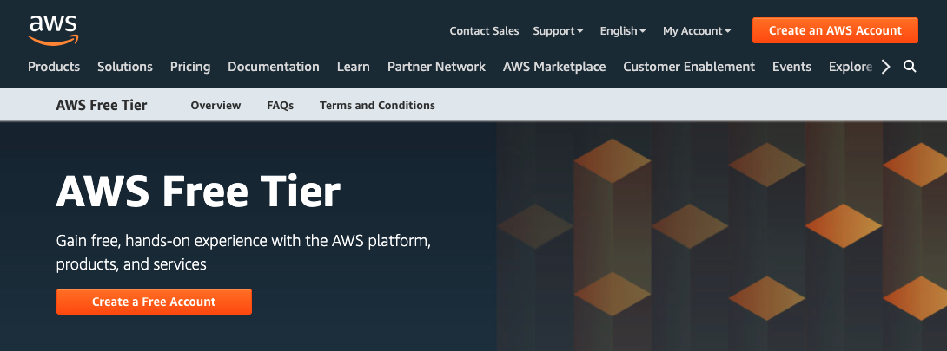
Delete AWS Resources
Policies for the AWS free tier and trials continually change.
You must remove any unnecessary resources created on AWS to avoid additional charges, especially Amazon SageMaker instances because AWS bills you for hosting the instances (even if they are stopped).

Slide 48
Delete AWS Resources
Follow these clean-up steps on AWS to delete AWS resources. Be sure to remove ALL of the following:
Endpoint
Endpoint configuration
Model
Notebook instance

Slide 49
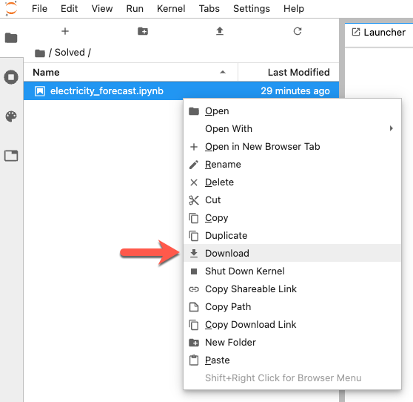
Delete AWS Resources
Remember:
you can save a local copy of the Jupyter notebooks by right-clicking on the notebook name and selecting the Download option.

